Slide 1
Lambda Calculus: An Introduction
Adapted from Lectures by
Professors of various universities

Slide 2
Outline
Why study lambda calculus?
Lambda calculus
Syntax
Evaluation
Relationship to programming languages

Slide 3
Lambda Calculus. History.
A framework developed in 1930s by Alonzo Church to study computations with functions
Church wanted a minimal notation
to expose only what is essential
The smallest universal programming language of the world
Universal-Any computable function can be expressed and evaluated
Two operations with functions are essential:
function creation
function application

Slide 4
Function Creation
Church introduced the notation
λx. E
to denote a function with formal argument x and with body E
Functions do not have names
names are not essential for the computation
Functions have a single argument
Only one argument functions are discussed

Slide 5
History of Notation
Whitehead & Russel (Principia Mathematica) used the notation ˆ P to denote the set of x’s such that P holds
Church borrowed the notation but moved ˆ down to create ∧x E
Which later turned into λx. E and the calculus became known as lambda calculus
x

Slide 6
Function Application
The only thing that we can do with a function is to apply it to an argument
Church used the notation
E₁ E₂
to denote the application of function E₁ to actual argument E₂
E₁ is called (ope)rator and E₂ is called (ope)rand
All functions are applied to a single argument

Slide 7
Why Study Lambda Calculus?
λ-calculus has had a tremendous influence on the design and analysis of programming languages
Realistic languages are too large and complex to study from scratch as a whole
Typical approach is to modularize the study into one feature at a time
E.g., recursion, looping, exceptions, objects, etc.
Then we assemble the features together

Slide 8
Why Study Lambda Calculus?
λ-calculus is the standard testbed for studying programming language features
Because of its minimality
Despite its syntactic simplicity the λ-calculus can easily encode:
numbers, recursive data types, modules, imperative features, exceptions, etc.
Certain language features necessitate more substantial extensions to λ-calculus:
for distributed & parallel languages: π-calculus
for object oriented languages: σ-calculus

Slide 9
Why Study Lambda Calculus?
“Whatever the next 700 languages turn out to be, they will surely be variants of lambda calculus.”
(Landin 1966)

Slide 10
Syntax of Lambda Calculus
Only three kinds of expressions
E ::= x variables
| E₁ E₂ function application
| λx. E function creation
The form λx. E is also called lambda abstraction, or simply abstraction
E are called λ-terms or λ-expressions

Slide 11
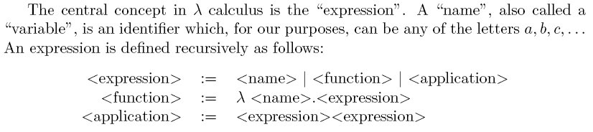

Slide 12
Examples of Lambda Expressions
The identity function:
I =_{def} λx. x
A function that given an argument y discards it and computes the identity function:
λy. (λx. x)
A function that given a function f invokes it on the identity function
λf. f (λ x. x)

Slide 13
Notational Conventions
Application associates to the left
x y z parses as (x y) z
Abstraction extends to the right as far as possible
λx. x λy. x y z parses as
λ x. (x (λy. ((x y) z)))
And yields the the parse tree:
λx
app
x
λy
app
app
z
x
y

Slide 14
Scope of Variables
As in all languages with variables, it is important to discuss the notion of scope
Recall: the scope of an identifier is the portion of a program where the identifier is accessible
An abstraction λx. E binds variable x in E
x is the newly introduced variable
E is the scope of x
we say x is bound in λx. E
Just like formal function arguments are bound in the function body

Slide 15
Free and Bound Variables
A variable is said to be free in E if it is not bound in E
We can define the free variables of an expression E recursively as follows:
Free(x) = { x}
Free(E₁ E₂) = Free(E₁) ∪ Free(E₂)
Free(λx. E) = Free(E) - { x }
Example: Free(λx. x (λy. x y z)) = { z }
Free variables are declared outside the term
A lambda expression with no free variables is called closed.

Slide 16
Free and Bound Variables (Cont.)
Just like in any language with static nested scoping, we have to worry about variable shadowing
An occurrence of a variable might refer to different things in different context
E.g., in Cool: let x ← E in x + (let x ← E’ in x) + x
In λ-calculus: λx. x (λx. x) x

Slide 17
Renaming Bound Variables
Two λ-terms that can be obtained from each other by a renaming of the bound variables are considered identical
Example: λx. x is identical to λy. y and to λz. z
Intuition:
by changing the name of a formal argument and of all its occurrences in the function body, the behavior of the function does not change
in λ-calculus such functions are considered identical

Slide 18
Renaming Bound Variables (Cont.)
Convention: we will always rename bound variables so that they are all unique
e.g., write λ x. x (λ y.y) x instead of λ x. x (λ x.x) x
Variable capture or name clash problem would arise!
This makes it easy to see the scope of bindings
And also prevents serious confusion !

Slide 19
Substitution
The substitution of E’ for x in E (written [E’/x]E )
Step 1. Rename bound variables in E and E’ so they are unique (α-reduction)
Step 2. Perform the textual substitution of E’ for x in E
Example: [y (λx. x) / x] λy. (λx. x) y x
After renaming: [y (λv. v)/x] λz. (λu. u) z x
After substitution: λz. (λu. u) z (y (λv. v))
Notes:
The definition of substituition that requires minimal renaming is quite complicated.
Historically, a number of mistakes have been made while formalizing it.
The approach taken here simplifies its definition considerably.

Slide 20
Evaluation of λ-terms
There is one key evaluation step in λ-calculus: the function application
(λx. E) E’ evaluates to [E’/x]E
This is called β-reduction
We write E →_{β} E’ to say that E’ is obtained from E in one β-reduction step
We write E →∗_{β} E’ if there are zero or more steps

Slide 21
Examples of Evaluation
The identity function:
(λx. x) E → [E / x] x = E
Another example with the identity:
(λf. f (λx. x)) (λx. x) →
[λx. x / f] f (λx. x)) = [(λx. x) / f] f (λy. y)) =
(λx. x) (λy. y) →
[λy. y /x] x = λy. y
A non-terminating evaluation:
(λx. xx)(λx. xx) →
[λx. xx / x]xx = [λy. yy / x] xx = (λy. yy)(λy. yy) → …

Slide 22
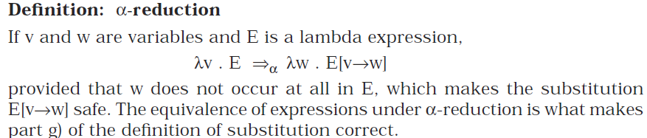
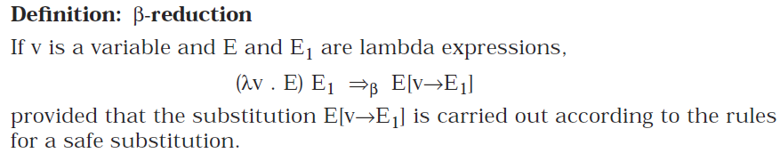
β- redex

Slide 23
Functions with Multiple Arguments
Consider that we extend the calculus with the add primitive operation
The λ-term λx. λy. add x y can be used to add two arguments E₁ and E₂:
(λx. λy. add x y) E₁ E₂ →_{β}
([E₁/x] λy. add x y) E₂ =
(λy. add E₁ y) E₂ →_{β}
[E₂/y] add E₁ y = add E₁ E₂
The arguments are passed one at a time

Slide 24
Functions with Multiple Arguments
What is the result of (λx. λy. add x y) E ?
It is λy. add E y
(A function that given a value E’ for y will compute add E E’)
The function λx. λy. E when applied to one argument E’ computes the function λy. [E’/x]E
This is one example of higher-order computation
We write a function whose result is another function

Slide 25
Evaluation and the Static Scope
The definition of substitution guarantees that evaluation respects static scoping:
(λ x. (λy. y x)) (y (λx. x)) →_{β} λz. z (y (λv. v))
(y remains free, i.e., defined externally)
If we forget to rename the bound y:
(λ x. (λy. y x)) (y (λx. x)) →∗_{β} λy. y (y (λv. v))
(y was free before but is bound now)

Slide 26
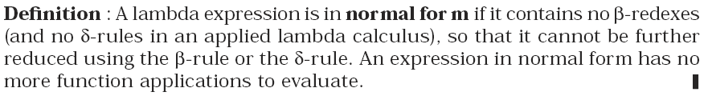
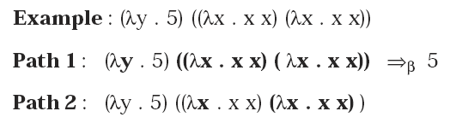

1. Can every lambda expression be reduced to a normal form?
2. Is there more than one way to reduce a particular lambda expression?

Slide 27
The Order of Evaluation
In a λ-term, there could be more than one instance of (λ x. E) E’
(λ y. (λ x. x) y) E
could reduce the inner or the outer \lambda
which one should we pick?
(λ y. (λ x. x) y) E
inner
outer
(λy. [y/x] x) E = (λy. y) E
[E/y] (λx. x) y =(λx. x) E
E

Slide 28
Order of Evaluation (Cont.)
The Church-Rosser theorem says that any order will compute the same result
A result is a λ-term that cannot be reduced further
A normal order reduction can have either of the following outcomes
1. It reaches a unique (up to a-conversion) normal form lambda expression
2. It never terminates
Notes:
Some evaluations may terminate while others may diverge. If two evaluations terminate, it will be to the same normal form.
DIAMOND PROPERTY (confluence)

Slide 29
Alan Turing proved a fundamental result, called the undecidability of the halting problem, which states that there is no algorithmic way to determine whether or not an arbitrary Turing machine will ever stop running. Therefore there are lambda expressions for which it cannot be determined whether a normal order reduction will ever terminate.
But we might want to fix the order of evaluation when we model a certain language
In (typical) programming languages, we do not reduce the bodies of functions (under a λ)
functions are considered values

Slide 30
Call by Name
Do not evaluate under a λ
Do not evaluate the argument prior to call
Example:
(λy. (λx. x) y) ((λu. u) (λv. v)) →_{βn}
(λx. x) ((λu. u) (λv. v)) →_{βn}
(λu. u) (λv. v) →_{βn}
λv. v

Slide 31
Call by Value
Do not evaluate under λ
Evaluate an argument prior to call
Example:
(λy. (λx. x) y) ((λu. u) (λv. v)) →_{βv}
(λy. (λx. x) y) (λv. v) →_{βv}
(λx. x) (λv. v) →_{βv}
λv. v

Slide 32
Call by Name and Call by Value
CBN
difficult to implement
order of side effects not predictable
CBV:
easy to implement efficiently
might not terminate even if CBN might terminate
Example: (λx. λ z.z) ((λy. yy) (λu. uu))
Outside the functional programming language community, only CBV is used

Slide 33
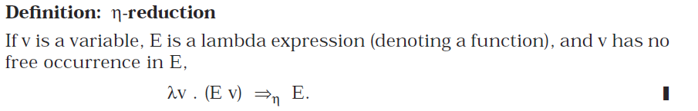

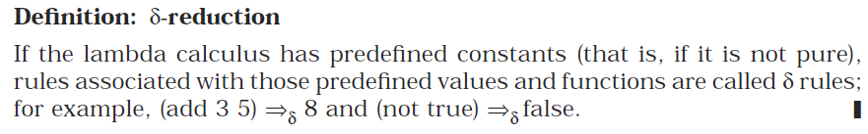
λx.(5 x) is not 5

Slide 34
Lambda Calculus and Programming Languages
Pure lambda calculus has only functions
What if we want to compute with Booleans, numbers, lists, etc.?
All these can be encoded in pure λ-calculus
The trick: do not encode what a value is but what we can do with it!
For each data type, we have to describe how it can be used, as a function
then we write that function in λ-calculus

Slide 35
Encoding Booleans in Lambda Calculus
What can we do with a boolean?
we can make a binary choice
A boolean is a function that given two choices selects one of them
true =_{def} λx. λy. x
false =_{def} λx. λy. y
if E₁ then E₂ else E₃ =_{def} E₁ E₂ E₃
Example: if true then u else v is
(λx. λy. x) u v →_{β} (λy. u) v →_{β} u

Slide 36
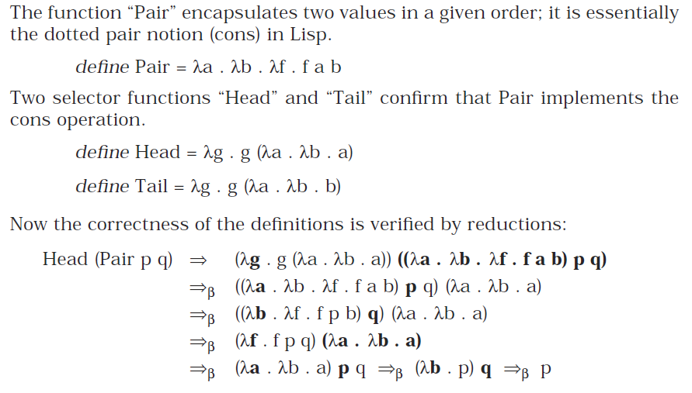
Encoding Pairs in Lambda Calculus

Slide 37
Encoding Natural Numbers in Lambda Calculus
What can we do with a natural number?
we can iterate a number of times
A natural number is a function that given an operation f and a starting value s, applies f a number of times to s:
0 =_{def} λf. λs. s
1 =_{def} λf. λs. f s
2 =_{def} λf. λs. f (f s)
and so on

Slide 38
Polymorphism
Functions that allow arguments of many types, such as this identity function, are known as polymorphic operations
((λx . x) E) = E
define Twice = λf . λx . f (f x)
If D is any domain, the syntax (or signature) for Twice can be described as
Twice : (D → D) → D → D
Given the square function, sqr : N → N where N stands for the natural numbers, it follows that
(Twice sqr) : N → N
Is twice a higher order function?
The mechanism that allows functions to be defined to work on a number of types of data is also known as parametric polymorphism

Slide 39
Addition
(int X int) → int ---not pure lambda calculus
(int → int) → int ----pure form (using currying)
λx.λy.x+y
Evaluate ((λx.λy.y x) 3) S

Slide 40
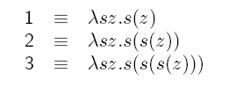
Computing with Natural Numbers
The successor function
successor n =_{def} λwyx.y(wyx)
Successor of 0 (S0) is _{def} (λwyx.y(wyx)) λsz.z
Successor of 1 (S1) is _{def} (λwyx.y(wyx)) λsz.s(z)
Addition
2S3 is _{def} (λsz.s(s(z)))(λwyx.y(wyx))(λuv.u(u(u(v))))

Slide 41
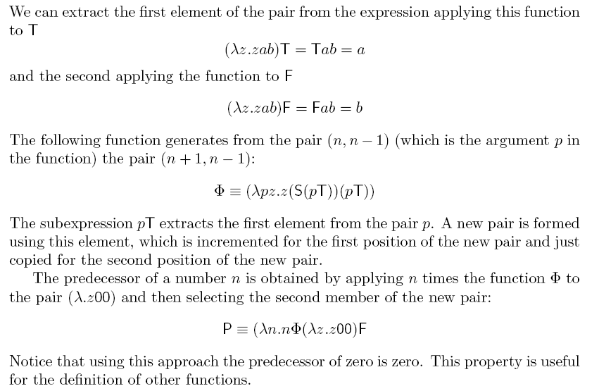
Predecessor function

Slide 42



Y Combinator
Y combinator can be defined as
Y = λt. (λx. t (x x)) (λx. t (x x))
Yt=t(Yt)=t(t(Yt))=…
(YT) 2=2

Slide 43
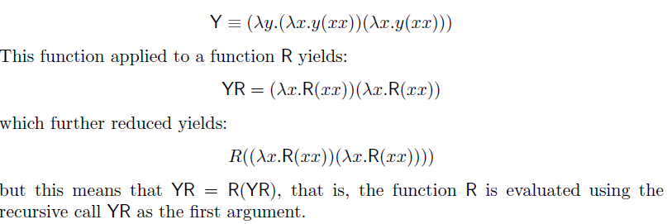


To compute sum of natural numbers from 0 to n
Zn0 : if n==0 then the result of the sum is 0 else the successor
function is applied n times through the recursive call (r)
To compute the sum of 0 to 3,
=> =>

Slide 44
Expressiveness of Lambda Calculus
The λ-calculus can express
data types (integers, booleans, lists, trees, etc.)
branching (using booleans)
recursion
This is enough to encode Turing machines
Encodings can be done
But programming in pure λ-calculus is painful
add constants (0, 1, 2, …, true, false, if-then-else, etc.)
add types

